Slide 1
InstaTask App
What this app do: Gig posting and searching for C2C and B2C
All our pages follow MVVM design pattern with clear separation of concerns.
Project members: Kuangcheng Lin (Peter), Adama Coulibaly, Carlos Castellanos , Chinchu Treesa Jose
One Activity Architecture
MVVM structural design pattern
Implemented Key android architecture components, such as ViewModel, Room, Navigation, and LiveData
Consuming (mock server) APIs with retrofit
Broadcast receivers for wifi/airplane mode
Google Map and functionalities

Slide 2
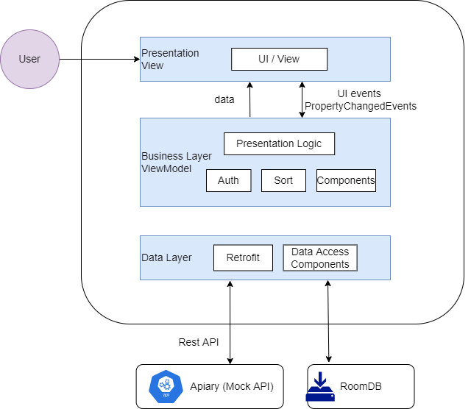

Slide 3

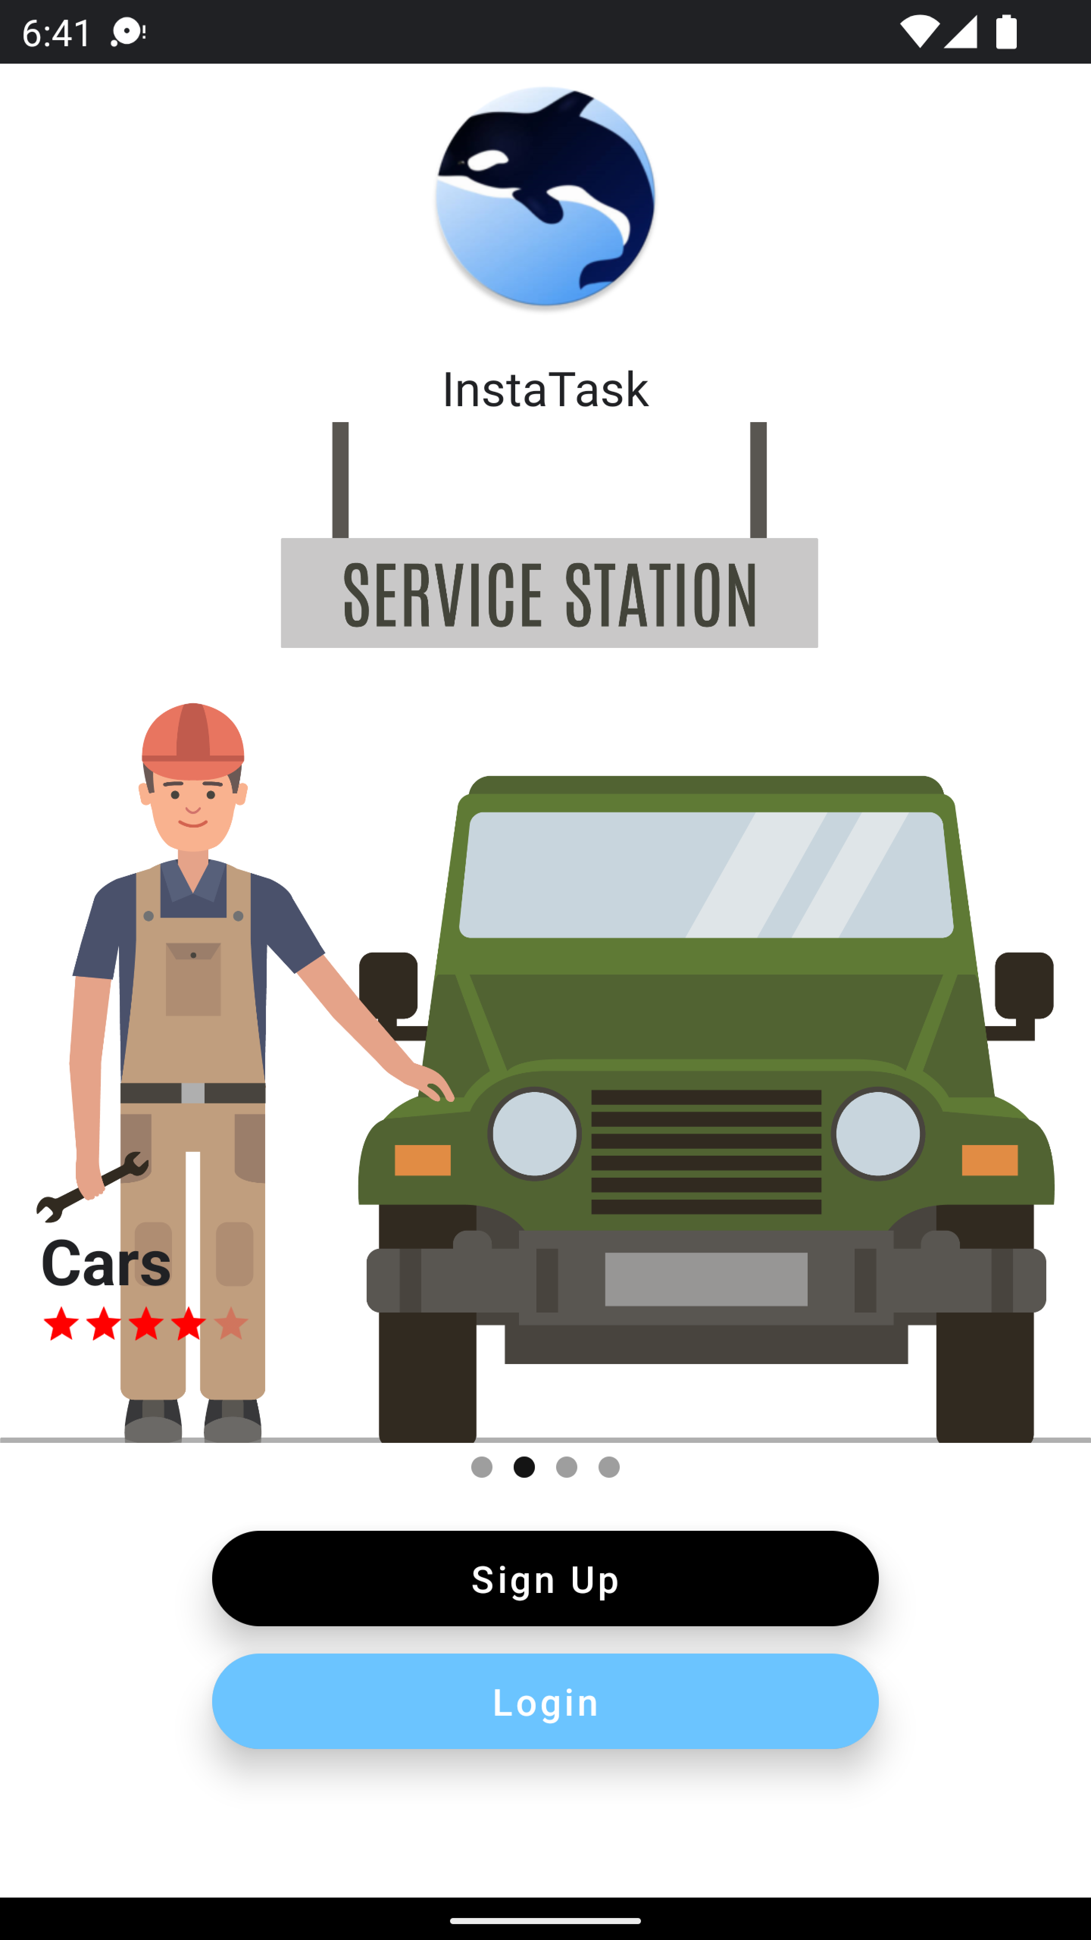
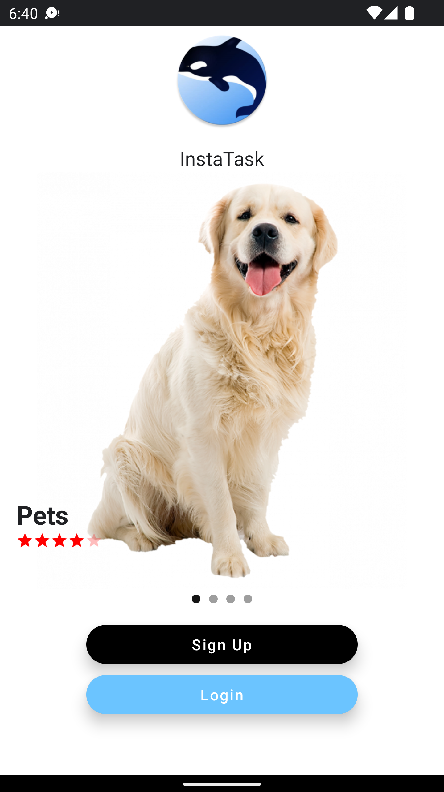
Adama Coulibaly
The Landing Page: (The pager )
Android Auto Image slider has been used for Job Categories

Slide 4
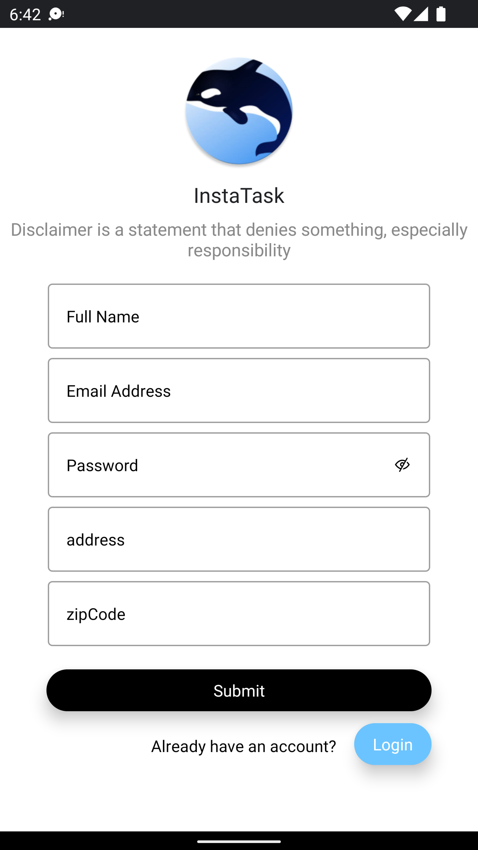
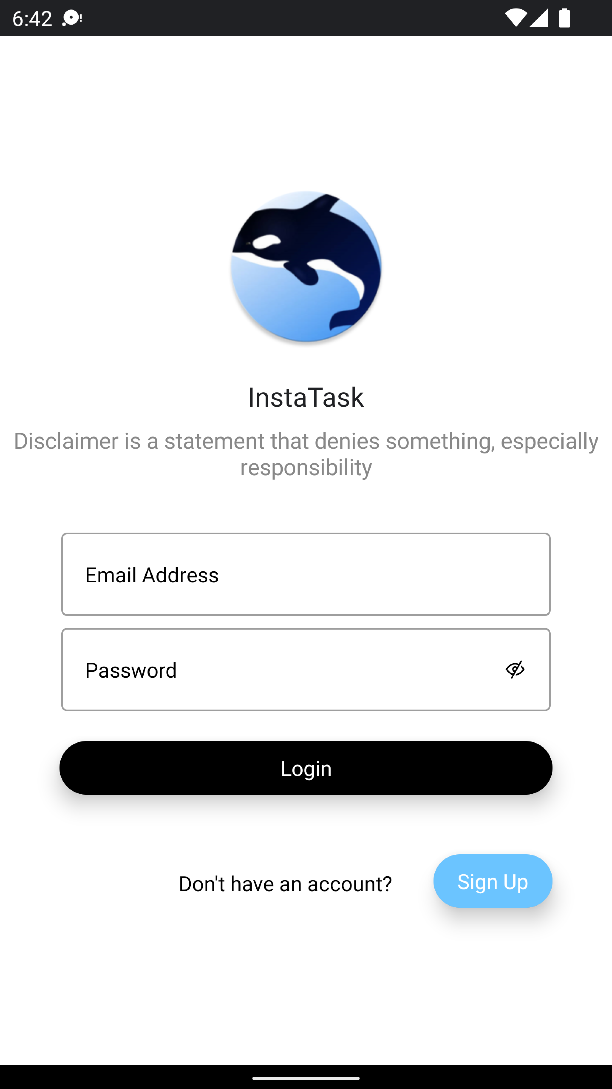
Adama Coulibaly
The Sign Up and Login Page:
The Room Database Design Pattern has been used to submit and retrieve new user in order to login to the App

Slide 5
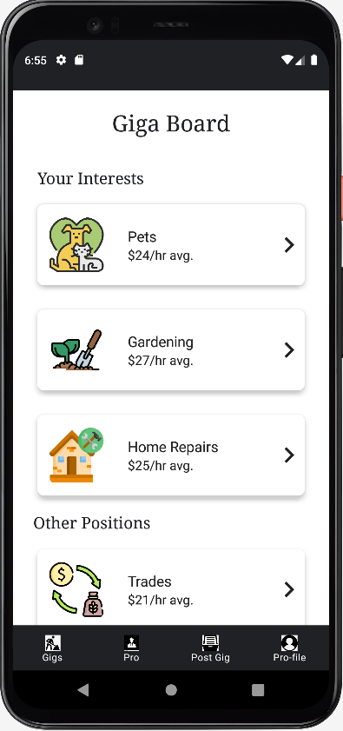
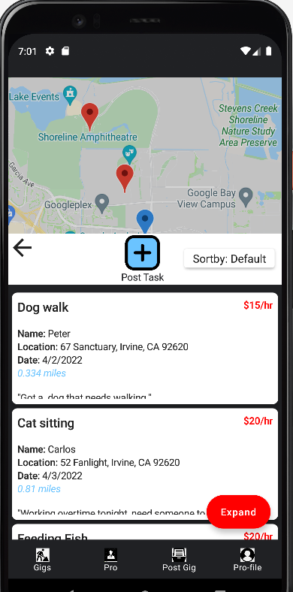
Gig Board
TaskBoard
Giga Board and TaskBoard is a c2c plateform where individuals can view, posts, and accept tasks from other individuals.
Giga Board's categories are pulled from API.
TaskBoard uses room database to persist data. It also uses google map, geocoding, and sorting

Slide 6
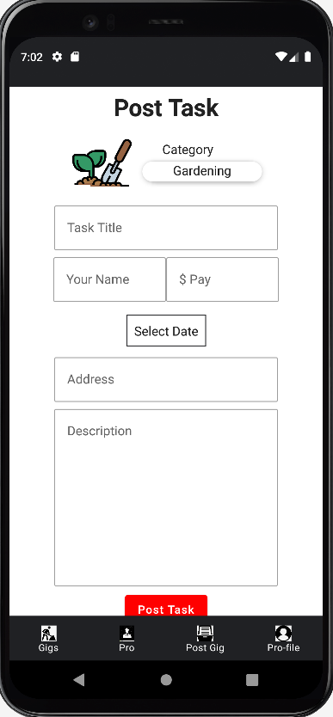
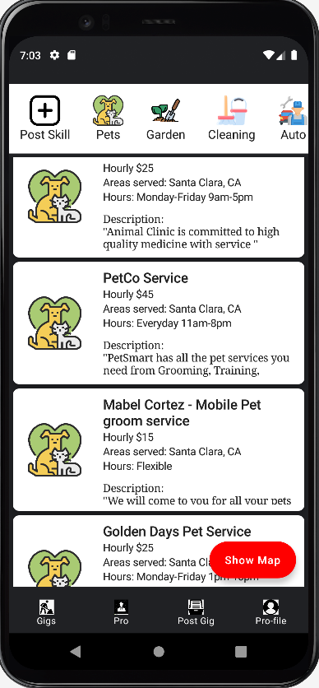
Post Task
ProBoard
Post Task add user input into room. It includes input validation, calendar component, and geocoding
ProBoard is a B2C board where individuals can browse and contact licensed companies for their services. Every category click will call its respective API for data

Slide 7
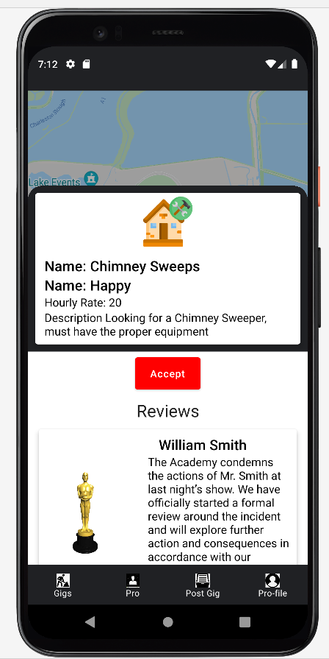
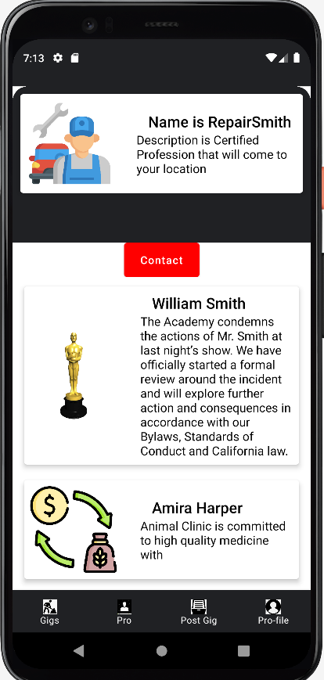
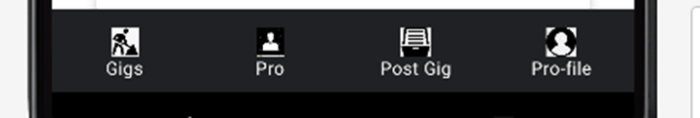

Slide 8
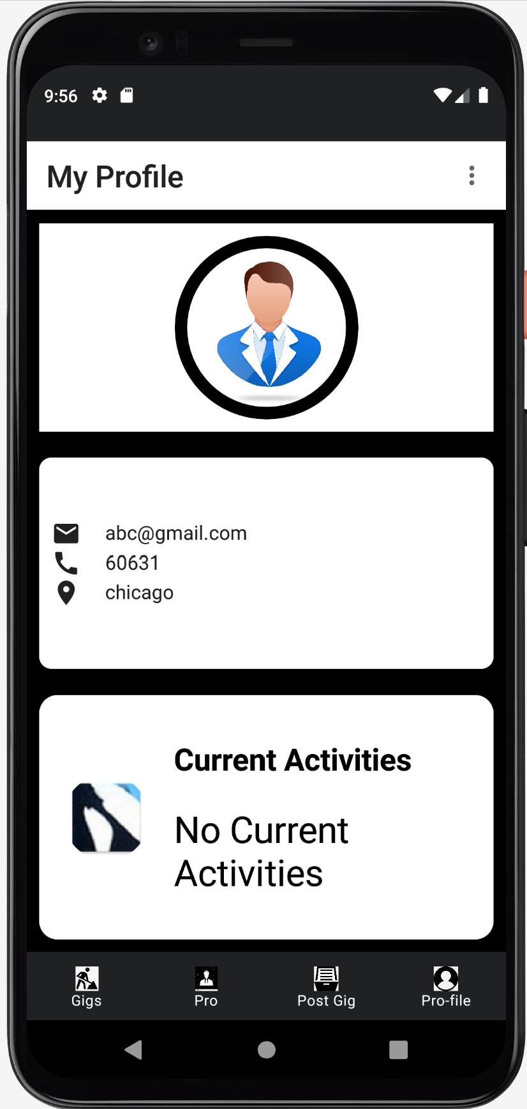
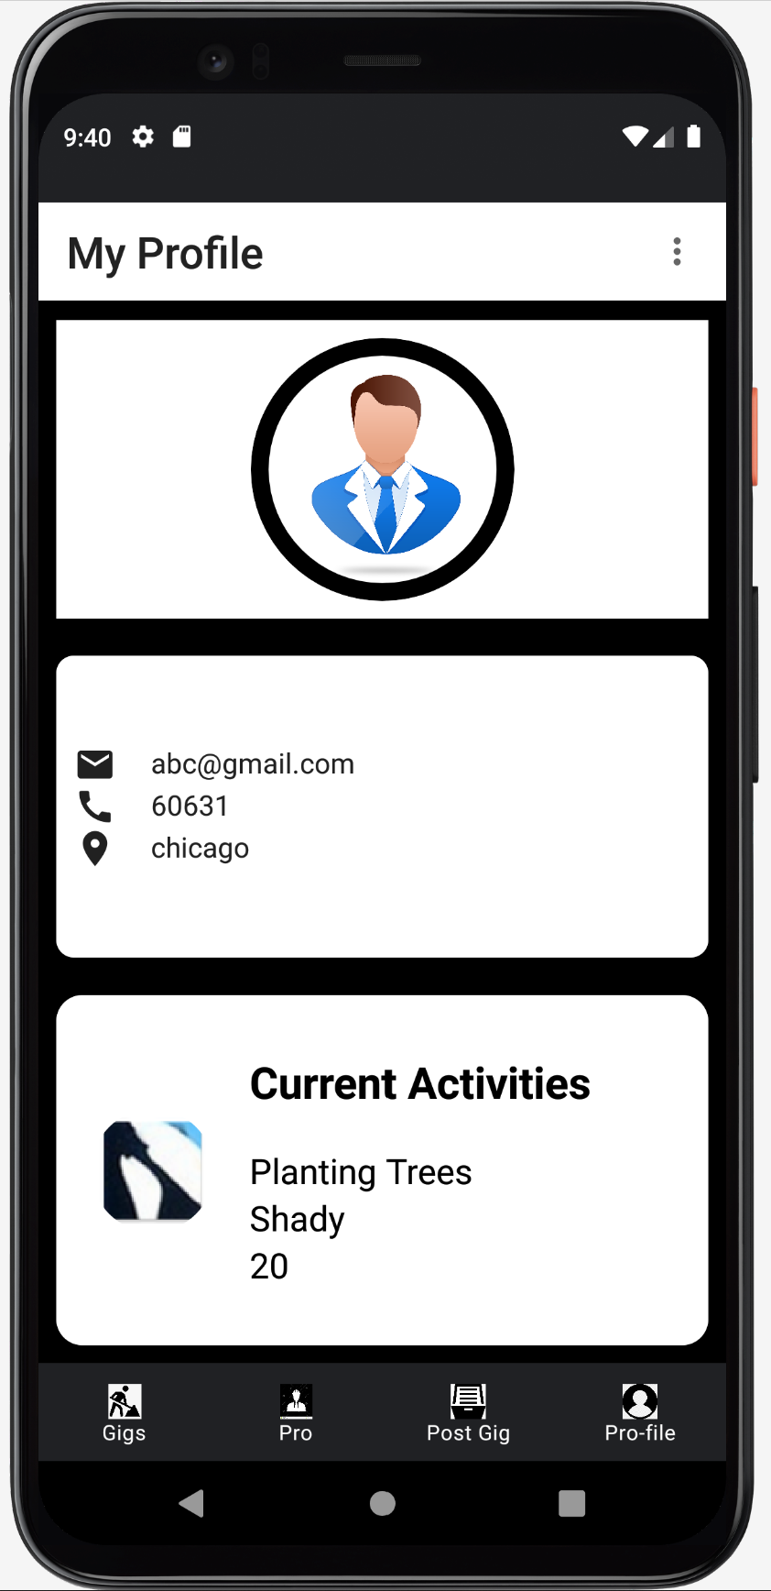
Chinchu Treesa Jose
Profile Screen
1.UserInfo retrieves data from the Database when logged in.
2.Current Activities get data from the job page when clicked .

Slide 9
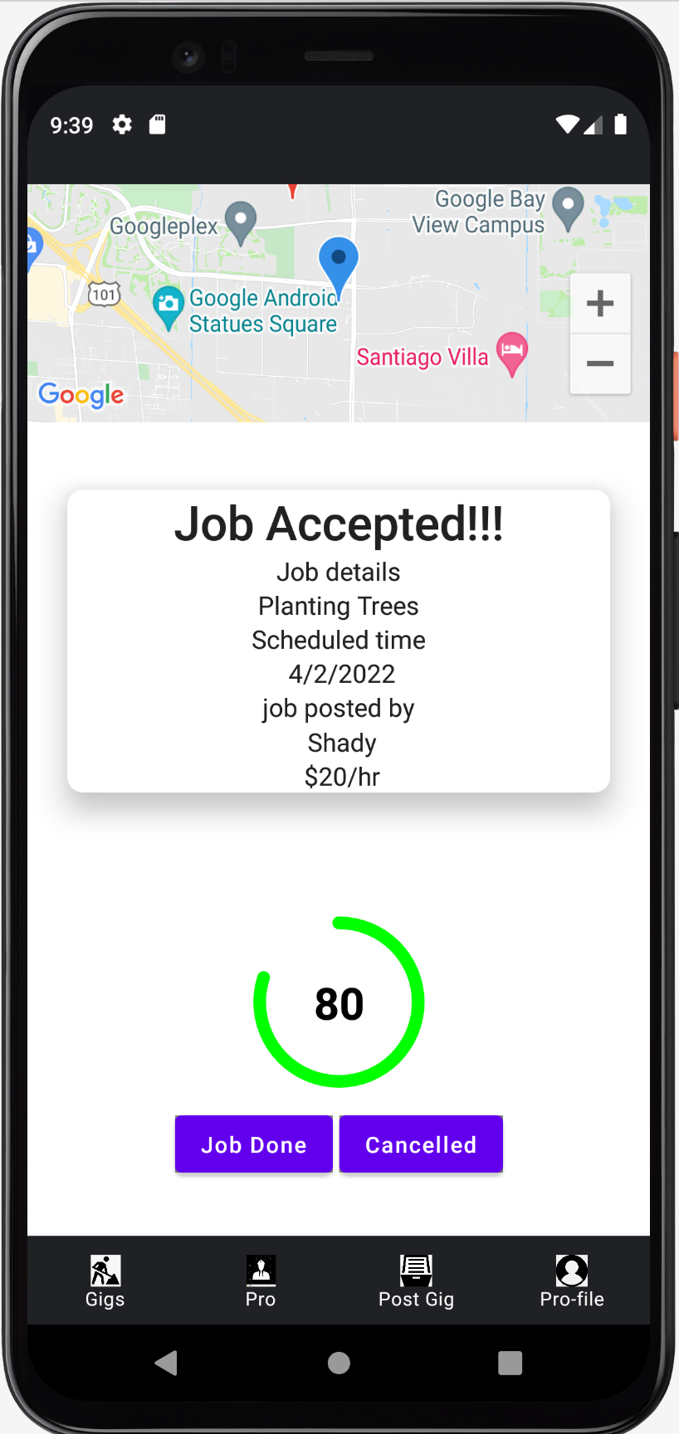
When Job Accepted
1.Job accepted when clicked the Accept button on Job page
2.Toast messages on click JobDone and Cancelled buttons
3.Progreesive bar shows the activity progress

